Slide 1
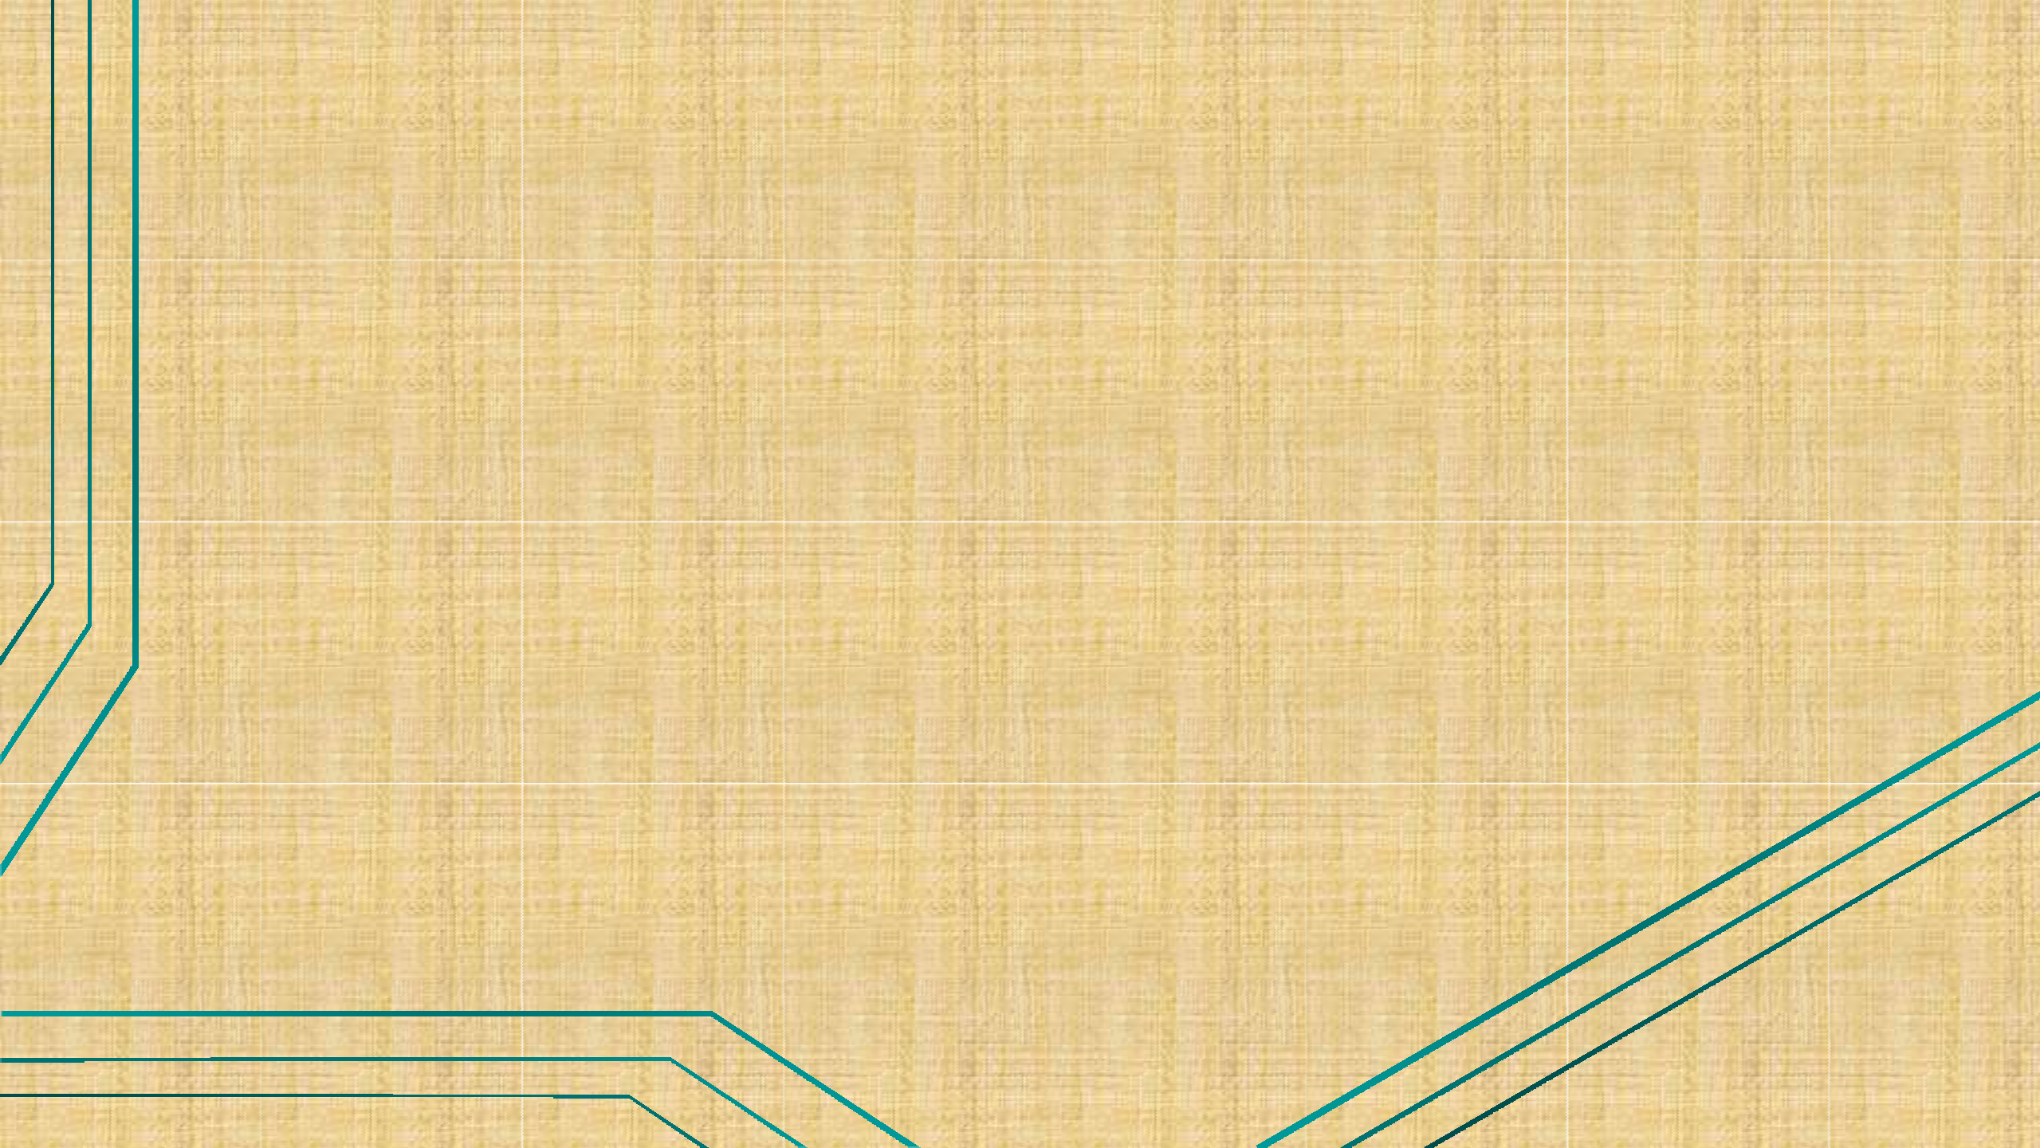


Templates in C++

Slide 2
Templates
Templates are the foundation of generic programming, which involves writing code in a way that is independent of any particular type.
We can use templates to define functions as well as classes

Slide 3
Generics:
It is a feature not a data type.
Using generic, we can write the code to support all the data type.
This concept is called generic programming.
Run time errors will find at compile time.
It increase the performance of code.
It reduce code repetition.

Slide 4
Function Templates
Syntax:
template <class Ttype>
returntype function_name (arguments)
{
…… // body of template function
……
}

Slide 5
Program:(function template)
#include<iostream>
using namespace std;
template <class t>
int mymax(t a,t b){
return(a>b?a:b);
}
int main(){
int c=mymax(6,5);
cout<<c<<endl;
float d=mymax(1.2,3.4);
cout<<d;
return 0;
}
Output:
6
3.4

Slide 6
Program:
#include<iostream>
using namespace std;
template <class t>
int add(t a,t b){
return a+b;
}
int main(){
cout<<add(5,6)<<endl;
float fresult=add(1.2,1.1);
cout<<fresult;
return 0;
}
Output:
11
2.3

Slide 7
Class Templates
Class can also be declared to operate on different data types. Such class are called class templates.
A class template specifies how individual classes can be constructed similar to normal class specification.
These classes model a generic class which support similar operations for different data types.
Syntax :
template <class T1, class T2, …..>
class class_name
{
// body
}

Slide 8
Program:
#include<iostream>
using namespace std;
template<class T>
class Calculater{
private:
T n1,n2;
public:
Calculater(T num1,T num2){
n1=num1;
n2=num2;
}
void show(){
cout<<"Addition is:"<<add()<<endl;
cout<<"Subtraction is:"<<sub()<<endl;
cout<<"multiplication is:"<<mul()<<endl;
cout<<"Division is:"<<div()<<endl;
}

Slide 9
T add(){
return (n1+n2);
} T sub(){
return (n1-n2);
}
T mul(){
return (n1*n2);
}
T div(){
return (n1/n2);
} };
int main(){
Calculater<int> obj(25,12);
Calculater<float> obj1(12.4,4.5);
obj.show();
cout<<endl;
obj1.show();
return 0; }
Output:
Addition is:37
Subtraction is:13
multiplication is:300
Division is:2
Addition is:16.9
Subtraction is:7.9
multiplication is:55.8
Division is:2.75556

Slide 10
Applications of Templates
Templates support generic programming, which allows to develop reusable software components such as function, class, etc.
Supporting different data types in a single framework.
A template in C++ allows the construction of a family of template functions and classes to perform the same operation on different data types.
It allows a single template to deal with a generic data type T.

